Slide 1
Secure Data Hiding In Images Using Steganography
CAPSTONE PROJECT
Presented By: Akash Rajendra Bambal
Student Name : Akash Rajendra Bambal
College Name & Department : Pimpri Chinchwad College of Engineering And Reseach, Pune &
Mechanical Engineering

Slide 2
OUTLINE
Problem Statement
Technology used
Wow factor
End users
Result
Conclusion
Git-hub Link
Future scope

Slide 3
Problem Statement
Traditional encryption methods are easily detectable, raising suspicion and making secure communication challenging. There is a need for a steganography-based approach to hide confidential messages within images while maintaining the integrity and quality of the cover image. Ensuring data security against unauthorized access and steganalysis attacks is crucial. Additionally, a user-friendly interface is required to make encryption and decryption accessible to non-technical users.

Slide 4
Technology used
Image Processing Libraries:
Python with libraries such as Pillow or OpenCV for manipulating and processing image files.
NumPy for handling pixel data and mathematical operations.
Graphical User Interface (GUI):
Tkinter or PyQt to build an intuitive, user-friendly interface for encryption and decryption processes.
File Handling:
Support for standard image formats such as PNG, JPEG, and BMP for compatibility with various types of images.
Data Security:
Protection mechanisms against steganalysis attacks and unauthorized extraction, ensuring that hidden data is not easily detected or retrieved by malicious parties

Slide 5
Wow factors
This project is a game-changer by seamlessly combining steganography and encryption to provide an almost undetectable method of hiding confidential messages within images, ensuring absolute privacy. The intuitive, non-technical interface makes secure communication accessible to everyone, not just experts. It features a unique lossless data hiding technique that manipulates pixel values without sacrificing image quality—making the embedded message invisible to the naked eye. Additionally, the solution supports various image formats, with PNG ensuring top-tier results, offering unparalleled flexibility. The seamless blend of security, user-friendliness, and robust image integrity makes this project truly stand out.

Slide 6
End users
Corporate Security Teams: Organizations seeking to securely transmit sensitive information, such as confidential documents, over unsecured communication channels while preventing unauthorized access.
Government Agencies: Security-conscious departments that require secure communication of classified data without the risk of detection, such as intelligence agencies.
Journalists and Activists: Individuals working in high-risk environments who need to protect sensitive information, communications, or whistleblower data, ensuring it remains hidden and safe from government or corporate surveillance.
Private Individuals: Users interested in protecting personal data, such as passwords or confidential communications, who may wish to use everyday images for hidden data transmission without alerting potential eavesdroppers.
Developers and Security Professionals: Technical users who wish to integrate steganography solutions into their applications or systems, ensuring that confidential information can be safely embedded into images for secure data exchange.
Cryptography Enthusiasts and Researchers: Individuals exploring advanced encryption, steganography techniques, or researching vulnerabilities and innovations in data security.
Educational Institutions: Schools or universities that want to teach or demonstrate secure communication practices through the use of steganography in their cybersecurity curriculum.

Slide 7
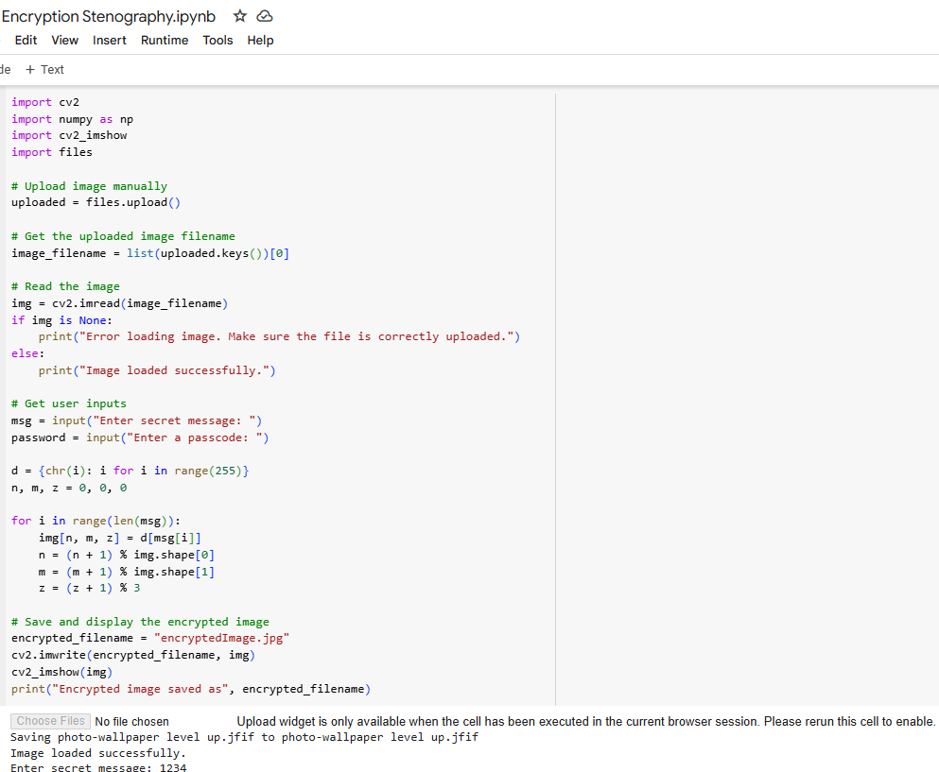
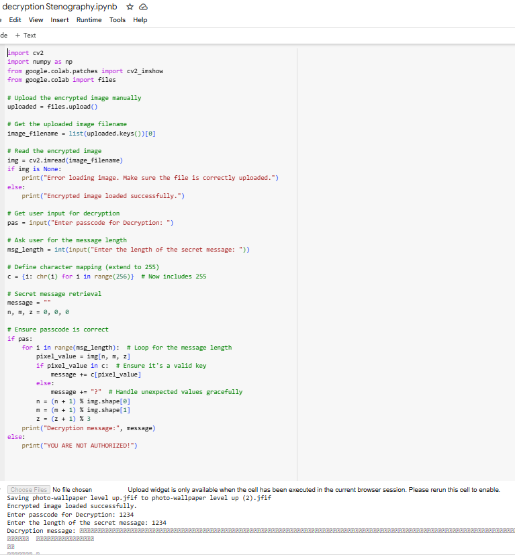
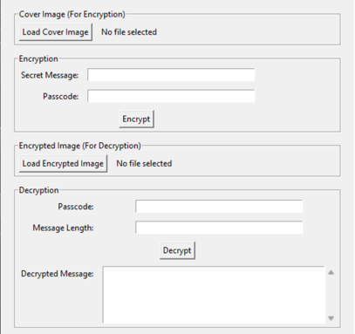

Results
Decryption Code:
Encryption Code: GUI:
Input Image File:
Output Image File:

Slide 8
Conclusion
In conclusion, the Secure Data Hiding in Images Using Steganography project successfully addresses the limitations of traditional encryption methods by providing a discreet and highly secure way to hide confidential messages within images. By leveraging steganography, this system ensures that the embedded data remains invisible and undetectable, preserving the integrity and quality of the cover image. The user-friendly interface makes encryption and decryption processes accessible to individuals with little to no technical knowledge, broadening its usability. This solution ensures robust data security, protecting sensitive information from unauthorized access, while offering a practical, efficient, and accessible approach to secure communication.

Slide 9
GitHub Link
https://github.com/The-Akash007/Stenography-Cybersecurity.git

Slide 10
Future scope(optional)
Advanced Steganographic Algorithms: Integrating more sophisticated steganographic techniques like Adaptive Steganography or Machine Learning-based Methods to increase robustness and resistance to steganalysis attacks, making the hidden data even harder to detect.
Support for Multimedia Data: Expanding the project to support video and audio files for embedding hidden data, enabling secure communication through various multimedia channels.
Cloud Integration: Enabling the ability to upload and securely share hidden messages through cloud services, integrating with platforms like AWS or Google Cloud, enhancing scalability and accessibility.
Compression and Encryption Optimization: Further optimizing the compression algorithms and encryption techniques to reduce the size of hidden data while maintaining a high level of security and image quality.
Cross-Platform Support: Developing versions of the tool for mobile devices (Android/iOS) and web applications, making it more accessible and versatile for end-users across multiple platforms.
Real-Time Communication: Creating a real-time communication platform that embeds hidden data in images exchanged over messaging apps, offering seamless and secure messaging for users.
Integration with Blockchain: Utilizing blockchain technology to ensure data integrity and verify the authenticity of messages, providing an additional layer of security to prevent tampering with the hidden data.
Data Analytics and Forensics: Incorporating features for data forensics, allowing users to analyze images for potential hidden messages or ensure the authenticity of received data, while maintaining privacy.

Slide 11
THANK YOU

